Slide 1
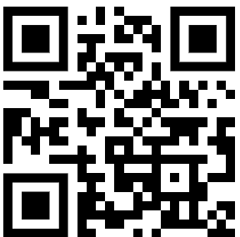
Mastering Agents,
MCP and other hypes
Dr. Damir Dobric
Lead Software Architect daenet GmbH / ACP Digital
Microsoft Regional Director,
Most Valuable Professional: AI+Azure

Slide 3
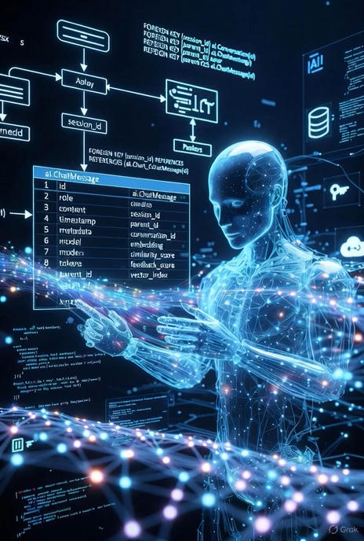

The new Software Era
Robots,
Quantum Computing
. . .
“After tomorrow”
“Tomorrow”
Today
AI & LLM Integration
Syntax Driven Languages

Slide 4
Model Interaction & Function Calling

Slide 5



Chat Completion Interaction
User: How are you?
(1)
AI
Prompt
(2)
Assistent: I‘m fine, how can I help you

Slide 6

Function Calling Interaction
User: Switch on the light to green.
LichtPlugin
SwitchLightOn(color)
SwitychLightOff
(1)
WeatherPlugin
ShowInfo(Location)
AI
Prompt
(2)
My Database
Tool: SwitchLightOn(green)

Slide 7
Function Calling Interaction
User: Switch on the light to green.
LichtPlugin
SwitchLightOn(color)
SwitychLightOff
(1)
WeatherPlugin
ShowInfo(Location)
AI
Prompt
(2)
My Database
Tool: SwitchLightOn(green)

Slide 8
Function Calling Interaction
{
"type": "function",
"function": {
"name": "get_weather",
"description": "Retrieves current weather for the given location.",
"strict": true,
"parameters": {
"type": "object",
"properties": {
"location": {
"type": "string",
"description": "City and country e.g. Bogotá, Colombia"
},
"units": {
"type": ["string", "null"],
"enum": ["celsius", "fahrenheit"],
"description": "Units the temperature will be returned in."
}
},
"required": ["location", "units"],
"additionalProperties": false
}
}
}

Slide 9
DEMO - Microsoft Agent Framework - Controlling the Light System - Natural Language to SQL

Slide 10
Model Context Protocol M C P

Slide 11
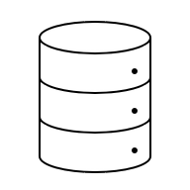



The issue with plugins
AGENT
Prompt to SQL Plugin
Lighting
Plugin
xy
Plugin
WhatEver

Slide 12
Model Context Protocol MCP
AGENT
MCP
MCP Server
Prompt to SQL Plugin
MCP Client
MCP
MCP Server Lighting
Plugin
MCP Client
MCP Server xy
Plugin
MCP Client
MCP
WhatEver

Slide 13
Model Context Protocol MCP: Local:stdio or Remote:HttpStream
AGENT
localhost
MCP Server
Prompt to SQL Plugin
MCP Client
MCP
HttpStream
MCP Server Lighting
Plugin
MCP Client
MCP
HttpStream
xy
Plugin
MCP Client
MCPStdio
MCP Server WhatEver

Slide 14
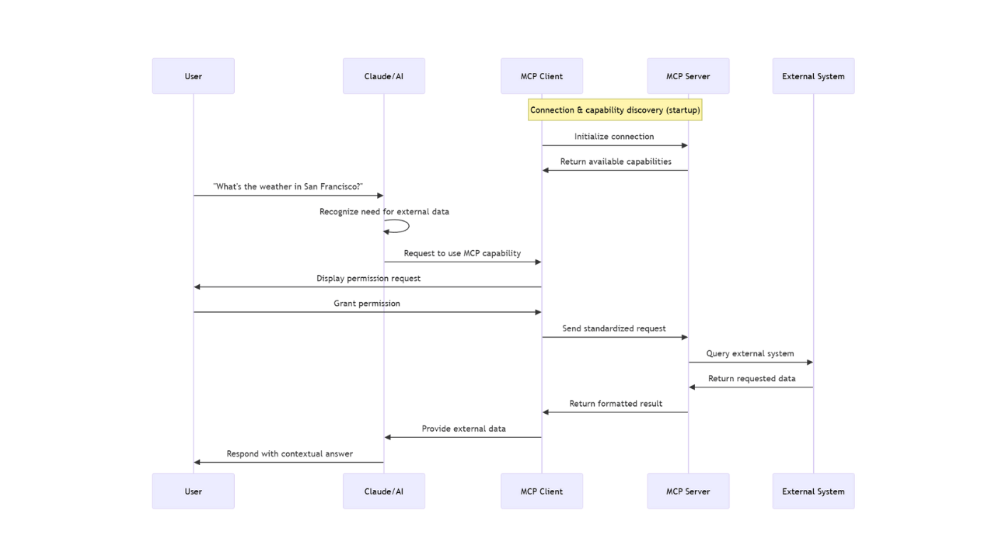

Slide 15
DEMO - MCP Server - MCP .NET SDK - MCP Client – MCP .NET SDK

Slide 16
Orchestrating Workflows with Gen AI
Model
Task1
. . .
TaskN

Slide 17
DEMO - Microsoft Agent Framework Plugin

Slide 18
Vibecoding How do we make software today?
Programming Language
Machine Code
compiler

Slide 19
Vibecoding The future?
Natural
Language
Programming Language
compiler
Machine Code
AI
Write on the screen following text: “Hello world”
Console.WriteLine(“Hello world”)

Slide 20
Dr. Damir Dobric
Lead Software Architect daenet GmbH / ACP Digital
Microsoft Regional Director,
Most Valuable Professional: AI+Azure

